Slide 1

Phase-VII The Prototype Design Research on Chest X-rays to deduct various respiratory infections
Guided by: Dr. Sabah Mohammed
Mohan Prasad Kutala
mkutala@lakeheadu.ca

Slide 2
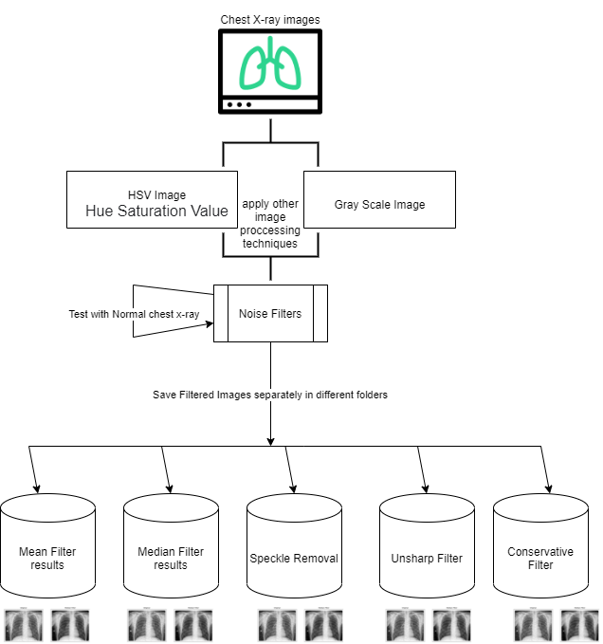
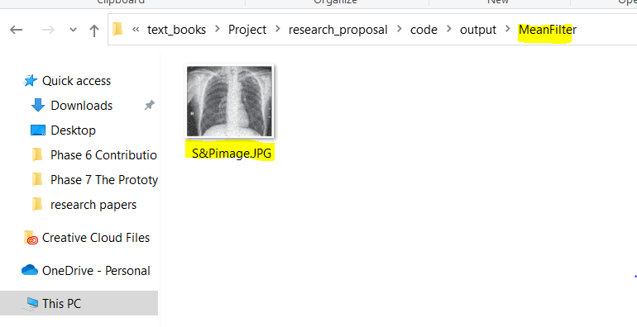
Prototype for Noise Cancelling
Images to HSV and Gray scale images by using OpenCV library
Different types of noise detecting and removing
store all the output images to different folders based on the filter name
Advantage of doing this is to test the same image by removing different noisy data
We will take sample of testing images to test the model on both diseases.
Sample expected output:

Slide 3
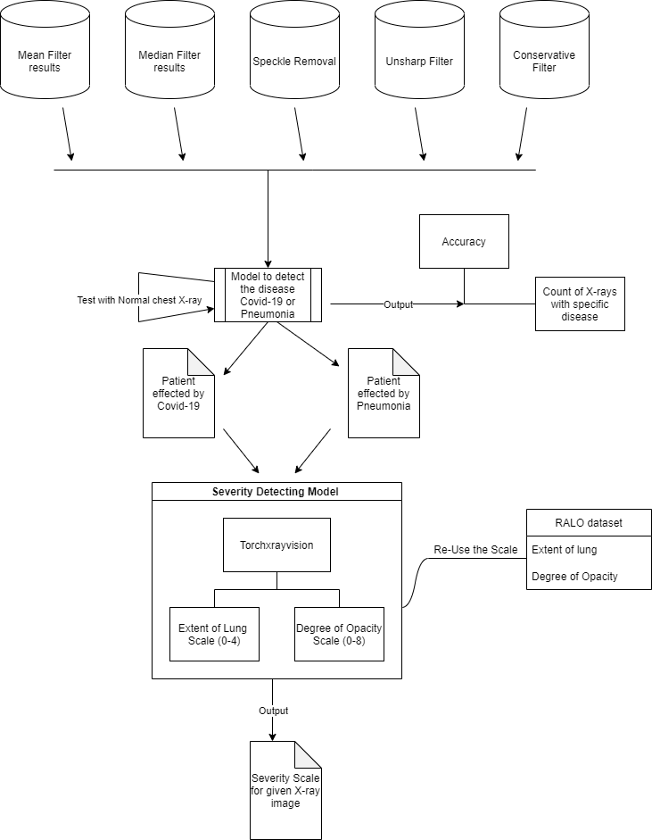
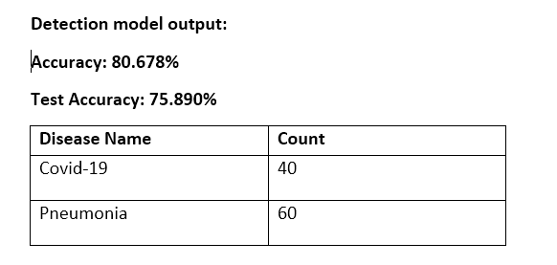

Prototype for Severity of the Disease
Testing on Deep learning models ex: DenseNet, VGG16, VGG19
Chest x-ray dataset
RALO dataset, PaO2 and FIO2, American lung association(Red,Green and Yellow)
Sample Expected Output
Sample Severity Output:

Slide 4


